Slide 1
Welcome!
Please, have a seat.
CWRU Quants
quants@case.edu
Notes:
CHristo

Slide 2
AGENDA
Meet the Team
Overview of Quant Finance
Club Structure and Projects
Preparation and Outcomes
Questions and Answers
Notes:
Christo

Slide 3
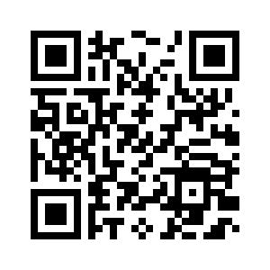
Attendance
Notes:
CHristo

Slide 4
GET TO
KNOW US!

Slide 5

MEET THE TEAM
Notes:
Christo

Slide 6
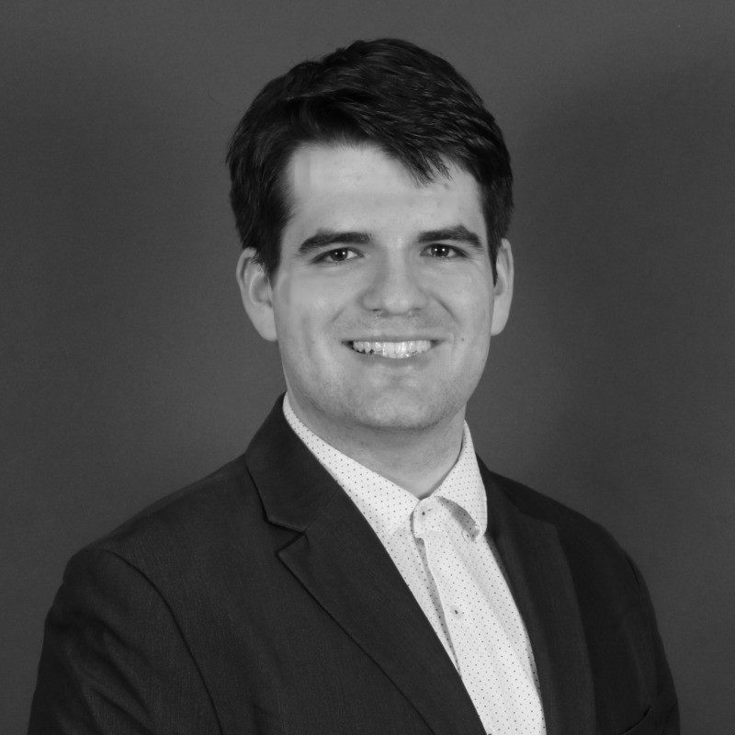

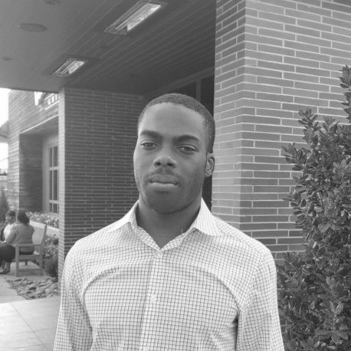
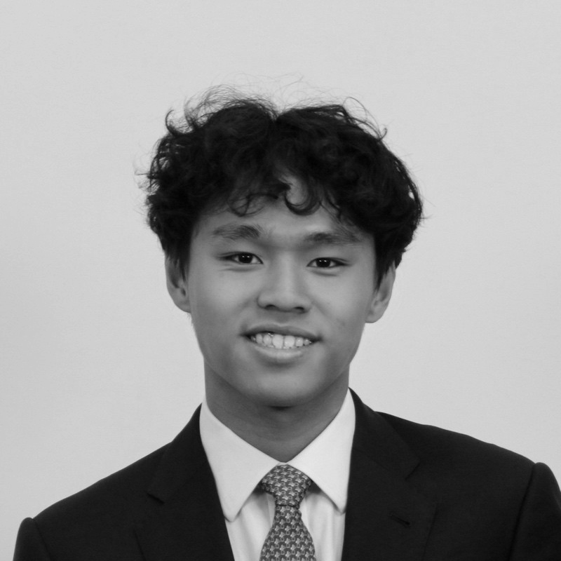
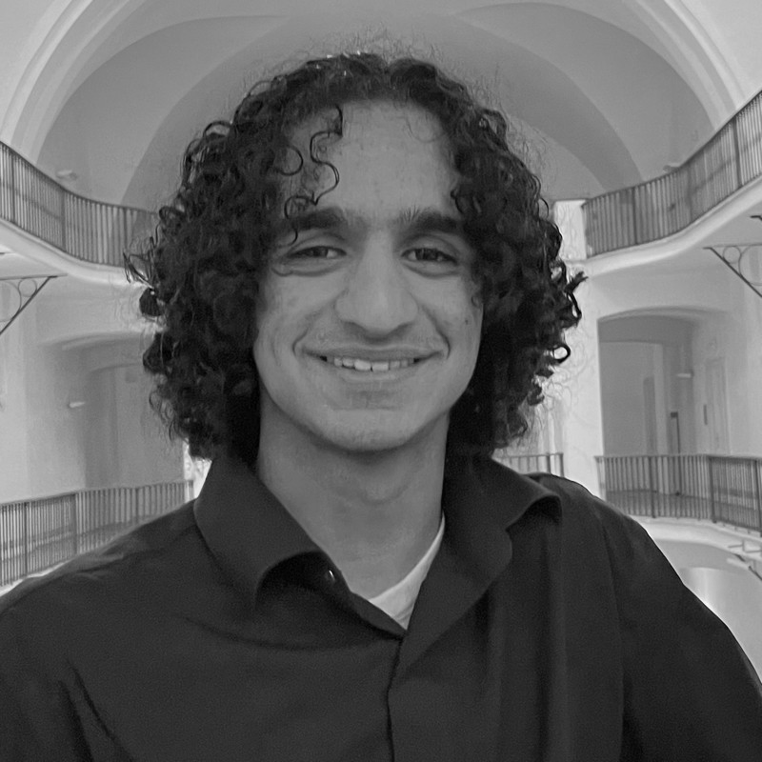
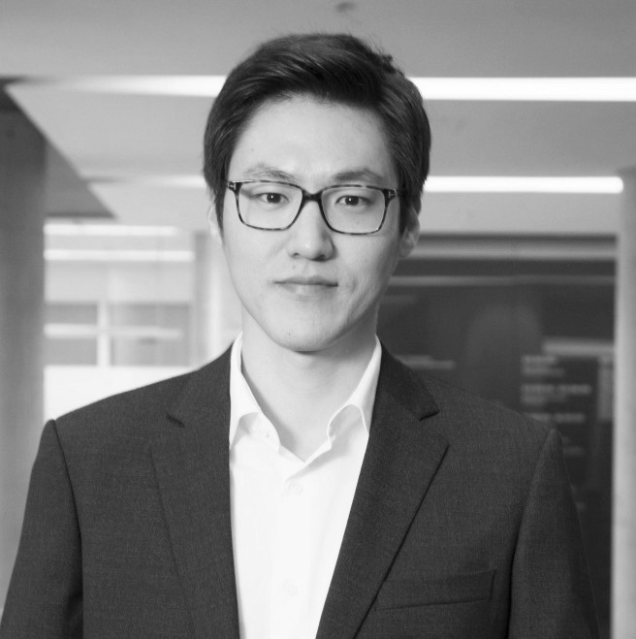
Executive Team
Christo Ekimov
President
Quant Econ and Finance Junior
Statistical Modeling @ CAT
Research @ Northwestern Kellogg School of Management
Ethan Fang
Vice President
Computer Science Junior / MS
Incoming Quant @ Keybank
ML Research @ Pruning Lab
Engineering @ MISCO
Ray Ikome
Head
CS and Math Sophomore
SWE @ Google
SWE @ Weatherhead
SWE @ Integrated Community Services
Tom Lin
Head
Econ and Math Sophomore
IB @ Roosevelt & Cross
SWE @ Trillium Trading
Research @ CWRU JoE
Sidharth Jindal
Head
Math BS/MS + Econ Sophomore
Research @ CWRU JoE
TA @ Weatherhead
Exec @ WES
Joon Woo Bae
Advisor
Assistant Professor of Finance
Notes:
Everyone

Slide 7
OVERVIEW OF QUANT FINANCE
Notes:
Ray Ikome

Slide 8
What is Quant Finance?
Math/Stats
Computing
Divisions
QF is concerned with the application of mathematical methods, data analysis, and computation to trading and investing in financial markets
Places a heavy emphasis on tech, from nanosecond optimized trading infrastructure to petabyte-scale big data pipelines
Sales and Trading, Financial Strategies & Research, Portfolio Management, Risk Management, Data Science roles
Notes:
Ray Ikome
The finance industry in the last 2-3 decades has undergone a transformation. Deregulation and technological advancements resulted in competing markets and reduced execution costs

Slide 9
Roles within Quant Finance
Quant Research (QR)
Quant Trading (QT)
Quant Dev (QD)
Work on designing new pricing models and strategies
Most mathematically rigorous work
Comp: 250k+
Execute new trades using programs and monitoring existing trades
Mental math and market making skills
Comp: 200k+
Developing, implementing, and maintaining programs used for new strategies
HPC and system-level programming knowledge
Comp: 200k+
Notes:
Ethan

Slide 10

CLUB STRUCTURE AND PROJECTS
Notes:
Sid

Slide 11
Club Structure and Projects
GB Structure
Projects
Education-focused to develop the skills/knowledge one needs to make an impact in groups
Project reviews, industry guest speakers, case studies, interview prep
Projects will explore an area of the markets and an area of quant finance
Examples of markets include equities, derivatives, and even sports/election betting
Projects will focus on development/research/trading
This is the club’s first year—things may change!
Notes:
Sid
Projects TBD – still figuring out what opportunities present themselves

Slide 12




Events
Social
Food
Networking
Poker Nights
Merch
Career
Workshops
Project Groups
Guest Speakers
Travel
Trading competitions
Conferences
Notes:
Tom
The finance industry in the last 2-3 decades has undergone a transformation. Deregulation and technological advancements resulted in competing markets and reduced execution costs

Slide 13
PREPARATION AND OUTCOMES
Notes:
Christo

Slide 14
Resources
Introduction
Advanced
Quantopian Lectures
lectures and learning
OpenQuant
resources, newsletter, jobs, mental math
ZetaMac
mental math
Research Papers (arxiv)
recent research papers
Quant Finance Hub
research, news, strategies
Notes:
Christo / Ethan

Slide 15
Poker Night
Our first event will be a poker night!
Details will be sent out by email when the time approaches, so stay tuned! It will be a great opportunity for networking and getting to know each other.
Notes:
Ray

Slide 16
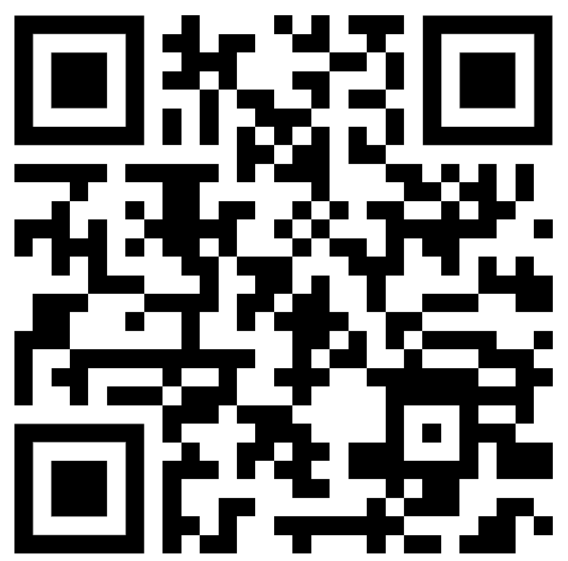
Tell us about you!
Notes:
Tom

Slide 17
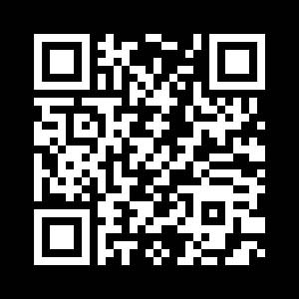
QUESTIONS
AND ANSWERS
Attendance
Contact us!
Email: quants@case.edu
Instagram: @cwruquants
Notes:
Sid

